Slide 1
Plant Diseases Detection
Machine Masters

Slide 2
Plant Diseases Detection
Unit 1. Introduction
1.1. Problem Statement
1.2. Solution Overview
Unit 2. Project Implementation
2.1. Dataset Overview
2.2. Project Results
Unit 3. Conclusion
3.1. Summary and Future Improvements

Slide 3
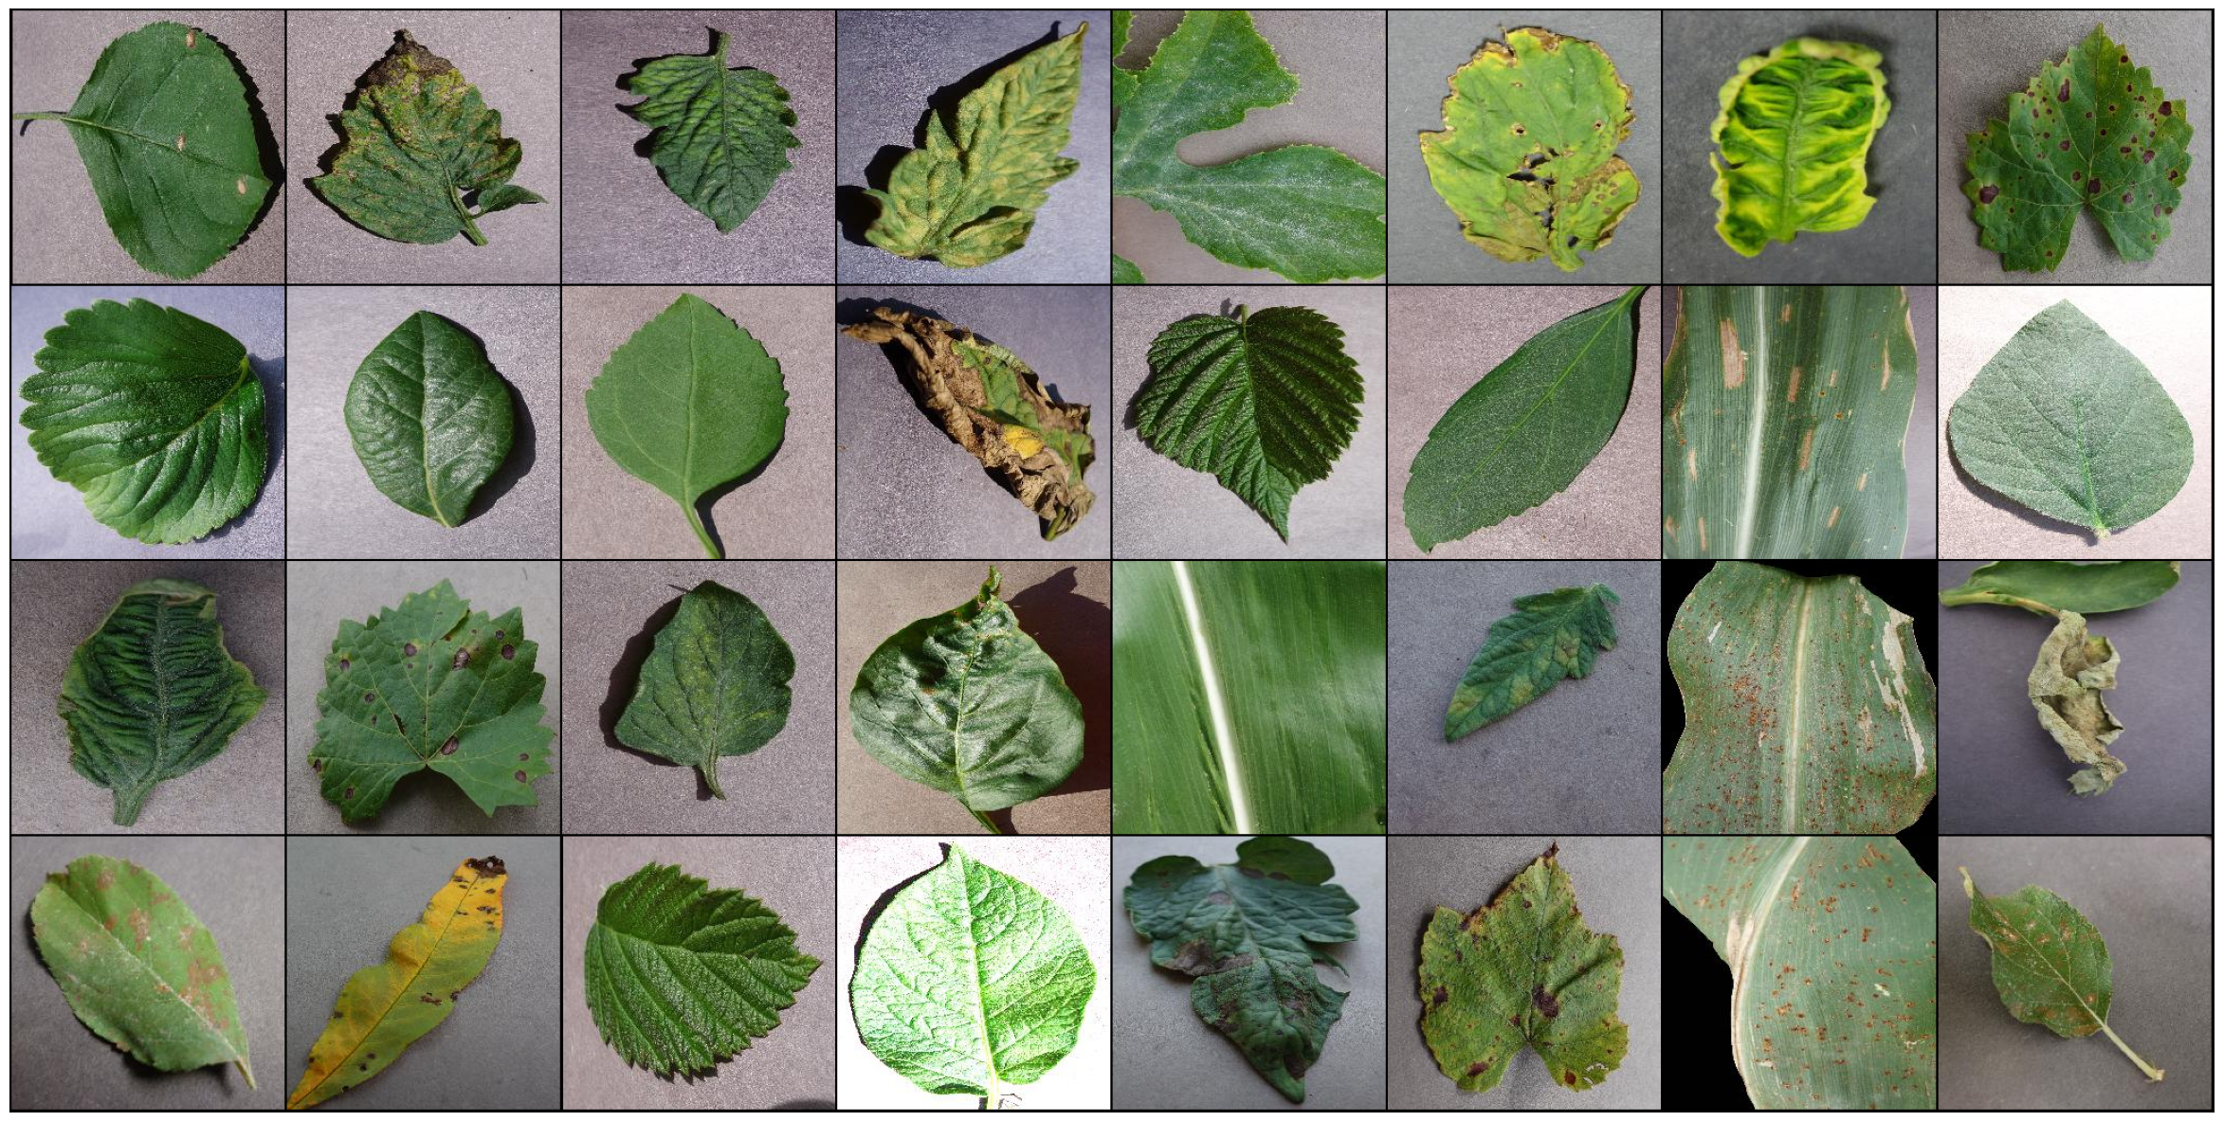
Problem Statement
1.1
Introduction
01
Plant disease detection remains a significant challenge in agriculture, leading to substantial crop losses and threats to food security. Traditional manual inspection methods are often time-consuming and inefficient, making it difficult to diagnose diseases early.

Slide 4
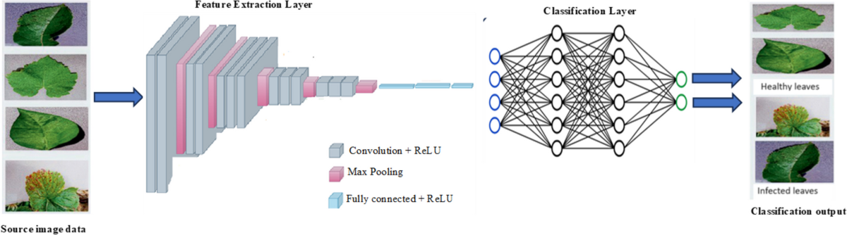
Solution Overview
1.2
Introduction
01
This project aims to enhance the agricultural sector by developing a reliable tool for early plant disease detection using leaf images. By using Convolutional Neural Networks (CNNs) and transfer learning
Fig: CNN Architecture

Slide 5
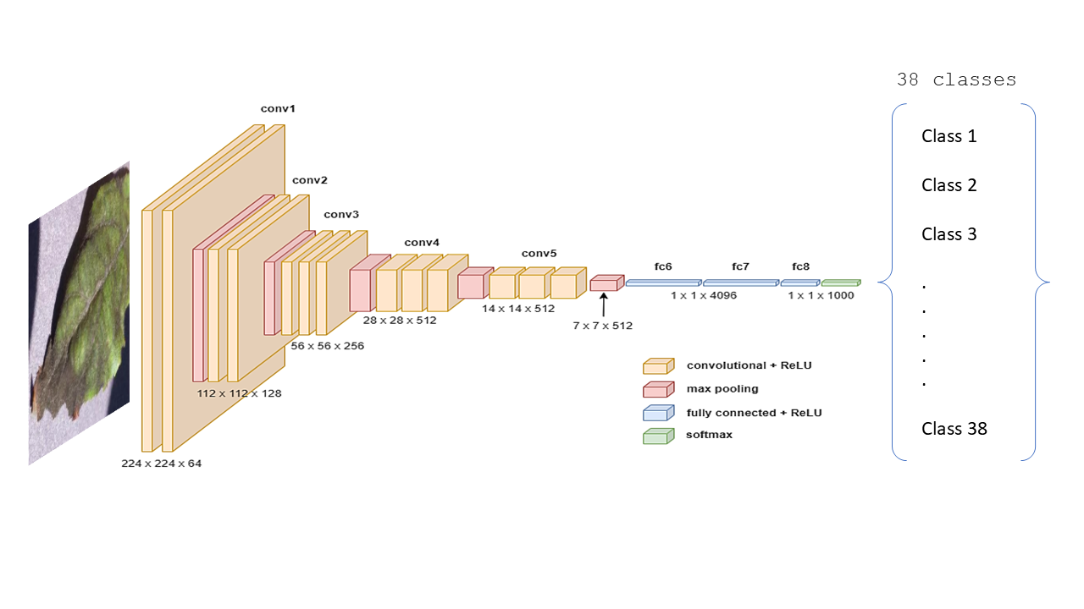
Solution Overview
1.2
Introduction
01
VGG16 is a deep CNN model with 16 layers, known for its high accuracy in image classification due to its ability to capture complex features. Its pre-trained weights can be fine-tuned with transfer learning.
Fig: VGG16 architecture

Slide 6
Dataset Overview
2.1
Project Implementation
02
Dataset sourced from Kaggle, containing ~87,000 RGB images of crop leaves.
Images categorized into 38 classes representing various diseases and healthy plant states.
Each image has a resolution of 256x256 pixels, showcasing distinct visual differences between healthy and diseased leaves.

Slide 7
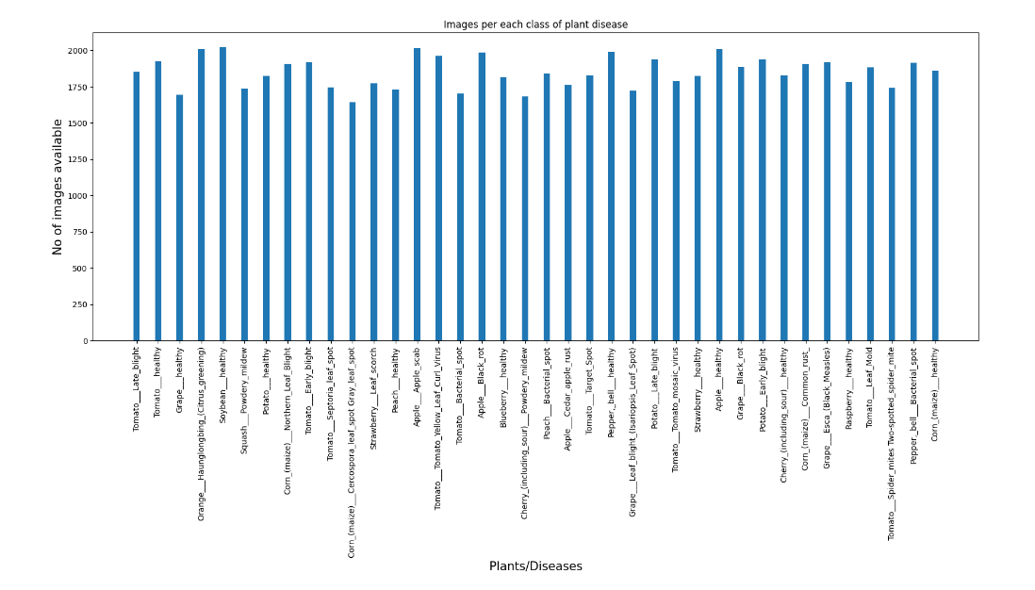
2.1
Project Implementation
02

Slide 8
Project Results
2.2
Project Implementation
02
Here is the accuracy of Custom CNN and VGG16 models
Model | Precision | Recall | F1-Score | Accuracy
￼￼Custom CNN | 0.60 | 0.53 | 0.53 | 0.53
VGG16 | 0.84 | 0.83 | 0.83 | ￼￼0.83

Slide 9
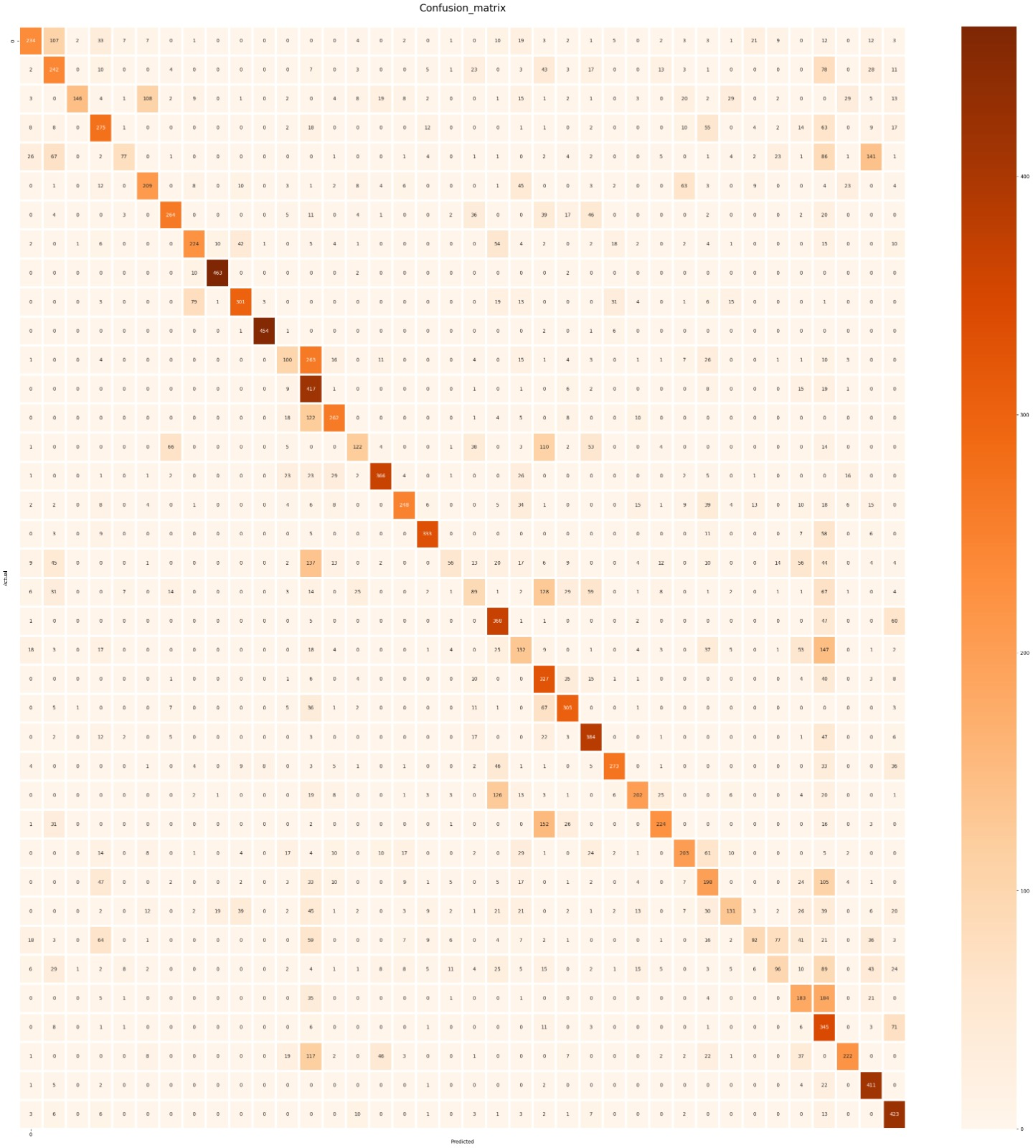
Project Results
2.2
Project Implementation
02
Custom CNN

Slide 10

Project Results
2.2
Project Implementation
02
VGG16

Slide 11
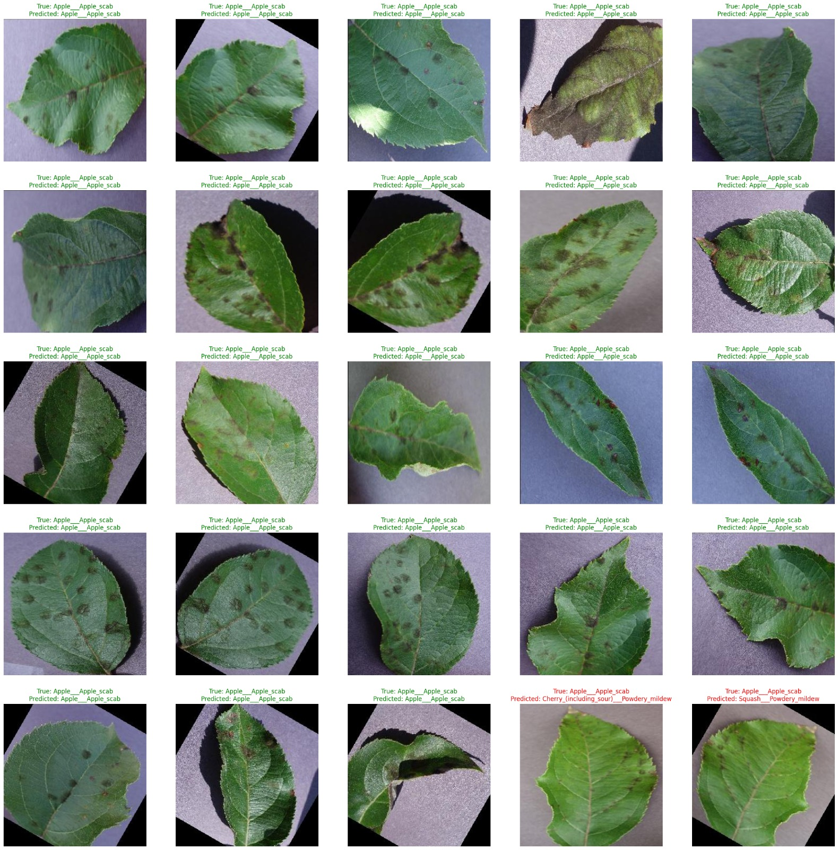

Project Results
2.2
Project Implementation
02
VGG16 | Custom CNN

Slide 12
Future Improvements
3.1
Conclusion
03
Improve the Custom CNN model accuracy
Expand dataset (crop/disease types)
Enable real-time mobile processing
Add farmer-friendly interface
Integrate IoT field data

